Slide 1

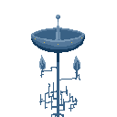
SOURCE
A Game About Robots
By Janek and Shannon

Slide 2
Source
A metroidvania style game in which you play a repairs droid on an alien planet.

Slide 3
The gameplay
Open world but the player is limited by their skill and gear
Enemies drop parts based on the area they’re killed in
Weapons are found at set points in levels
The player can take four weapons at once
The player can upgrade weapons as they go along
All weapons are equally powerful in different situations
Limited by charge that comes back over time
Still metroidvania style upgrades, but they aren’t required, they just make aspects easier

Slide 4
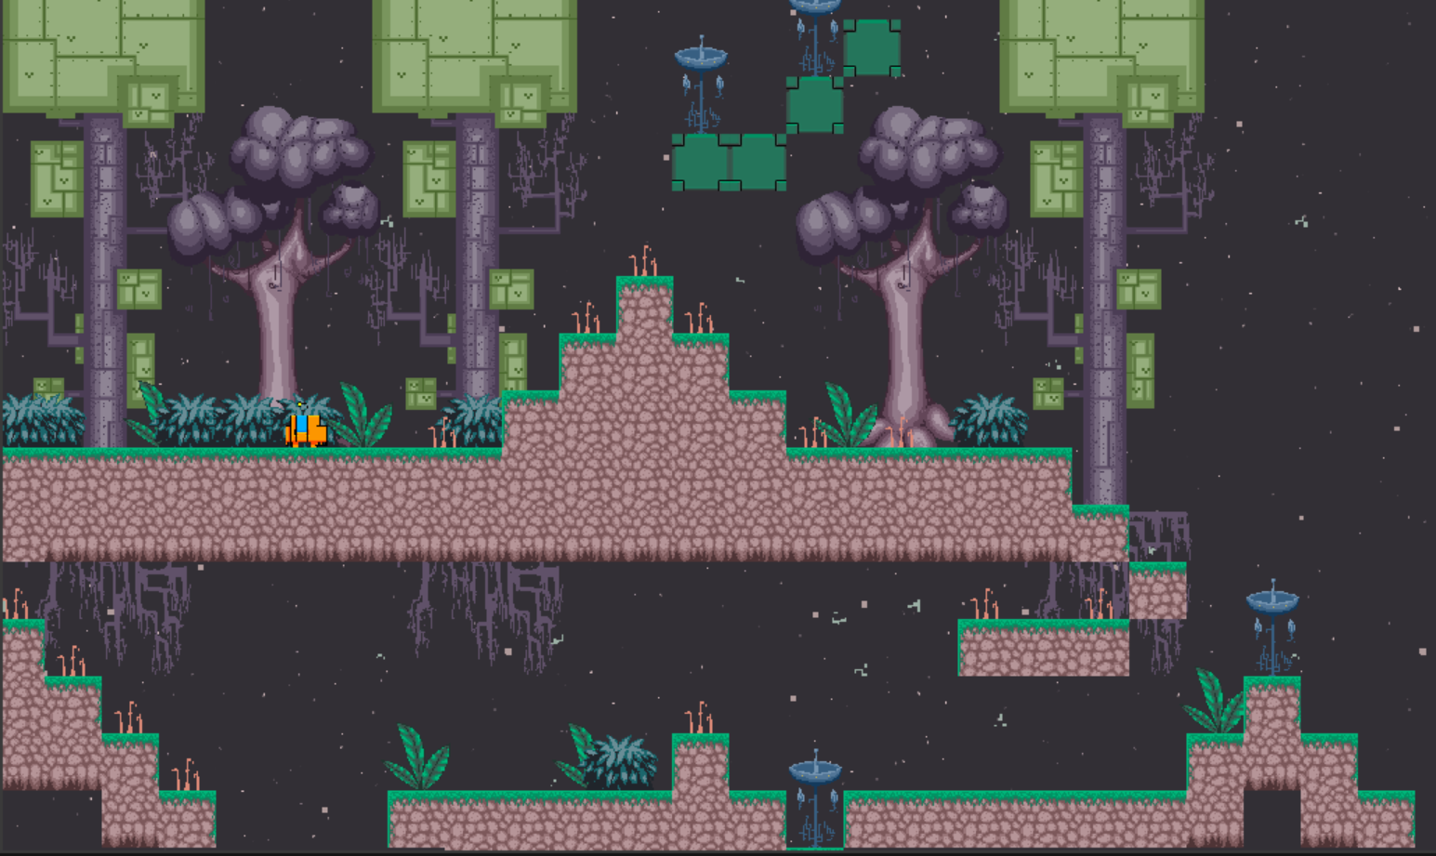
Last time...

Slide 5
Any Questions?

